Slide 1

REAL ESTATE PRICE PREDICTION
BY- ANSHIKA PURWAR & SANJANA GUPTA

Slide 2
PROBLEM STATEMENT -
In the world of buying and selling homes, it's tough to know exactly how much a property is worth. This makes it hard for people who want to buy, sell, or help others with their properties. The problem is that there's not enough good information available about how much homes should cost.
For instance, when someone wants to buy a house, they might not know if the price they're paying is fair because they don't have all the right information. The same goes for someone trying to sell—they might not be sure how much their house is worth. Even the people who work in real estate, like agents, can struggle because they don't always have all the info they need.

Slide 3
TRADITIONAL APPROACHES -
Comparative Market Analysis (CMA): Real estate agents would analyze recently sold properties in the area to estimate the price of a similar property. Factors such as size, location, amenities, and condition were considered.
Local Trends and Neighborhood Analysis: Understanding the local market dynamics, such as school quality, crime rates, development plans, and neighborhood changes, helped in predicting property prices.
Supply and Demand Dynamics: Basic economic principles of supply and demand played a crucial role. Low supply and high demand typically drove prices up, while an oversupply could lower prices.
Guidance and Advice: Real estate agents offer guidance and advice to buyers and sellers. They educate clients about market trends, potential investment opportunities, and factors influencing property prices, helping them make informed decisions.

Slide 4
PROBLEM WITH TRADITIONAL APPROCHES
Fraud - Customers depending upon the real estate agents get cheated as agent may provide price much higher than actual price.
Limited Scope and Speed: Manual methods took time to gather and process data, limiting the scope and depth of analysis. This delayed decision-making and hindered the ability to react quickly to rapidly changing market conditions.
Lack of Personalization: Traditional methods didn't account for individual preferences and behaviors effectively. They offered generalized estimations that might not align with specific buyer or seller needs.
Inefficiency in Handling Big Data: With the exponential growth of data in the digital age, traditional methods found it increasingly challenging to handle and analyze large volumes of data effectively.

Slide 5
PROJECT DESCRIPTION
To fix this, we need a smart system that can predict how much a house is worth. This system would look at lots of things like where the house is, how big it is, what special features it has, and what the market is like. By using this system, buyers, sellers, and agents could have a better idea of what a fair price for a house should be. This way, everyone involved can make smarter decisions about buying and selling homes.
Predictive models, particularly driven by machine learning, have revolutionized various sectors. By leveraging valid datasets, machine learning models decipher Project Title: Real Estate Price Prediction 4 of 8 the significance of specific events within systems, thus predicting outcomes based on learned patterns. From stock price forecasts to seismic activity predictions and sales projections, the applications are limitless. Our research project focuses on harnessing machine learning techniques to predict real-time house prices by considering essential parameters like square footage, bedroom and bathroom counts, flooring type, and location specifics, our model aims to offer accurate predictions. The dataset used in our analysis encompasses diverse scenarios to ensure reliable outcomes across different conditions. Through this project, we aim to provide a robust predictive tool that aids individuals and stakeholders in making informed decisions within the real estate market, ultimately empowering them to navigate the housing landscape with greater clarity and confidence.

Slide 6
MEATHODOLOGY
Phase 1 - Data Collection and Cleaning: • Gather data from multiple real estate websites, focusing on attributes like location, carpet area, built-up area, age of property, zip code, etc. • Check for inconsistencies, missing values, outliers, or duplicates in the collected data. • Cleanse the data by handling missing values (imputation), removing duplicates, and correcting inconsistencies.
Phase 2 - Quantitative Data Collection: • Focus on collecting structured and numerical data for quantitative analysis. • Ensure attributes are categorized correctly and represented in a structured format suitable for analysis.
Phase 3 - Feature Engineering and Selection: • Perform feature engineering to transform or derive new features from existing ones that could enhance the model's predictive power. • Select pertinent features for the predictive model based on their relevance to property prices

Slide 7
Phase 4 – Training The Model, Data Splitting and Validation: • Split the dataset into training and validation sets to train the model on one subset and evaluate its performance on another. • Validate the model's predictions against the validation set to assess its accuracy and generalizability

Slide 8
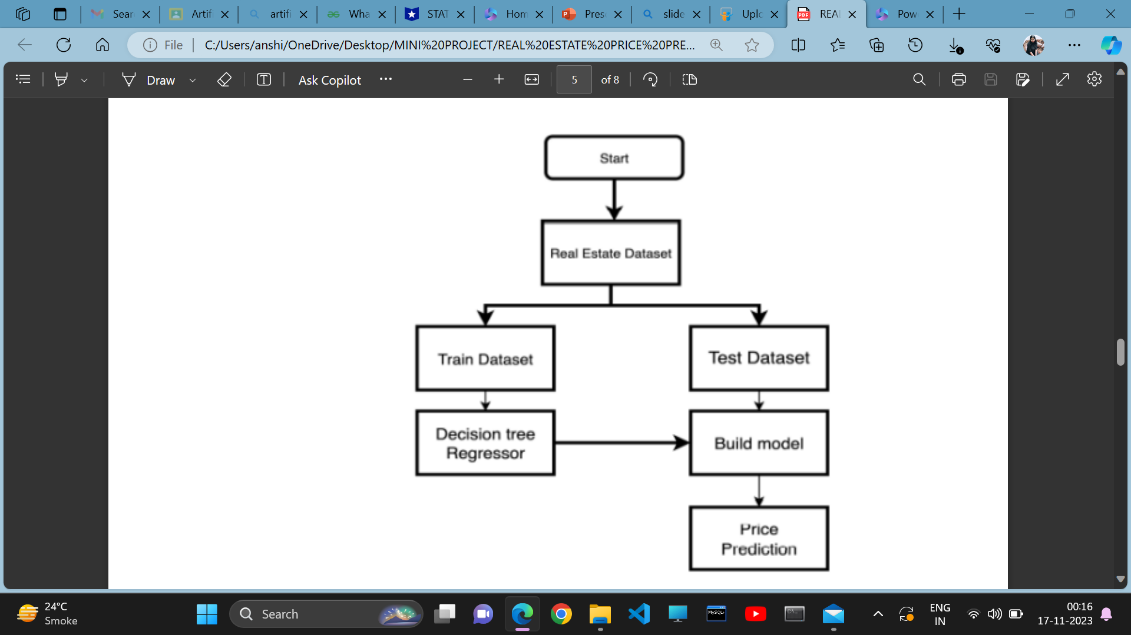

Slide 9
TOOLS USED
Pandas: For data manipulation, handling datasets, and performing data analysis tasks.
• NumPy: For numerical computations and operations on arrays and matrices.
• Matplotlib and Seaborn: For data visualization, creating plots, charts, and heatmaps.
• Scikit-learn: For machine learning algorithms, including regression models, data preprocessing, and model evaluation.

Slide 10
LINEAR REGRESSION
Linear regression is a type of supervised machine learning algorithm that computes the linear relationship between a dependent variable and one or more independent features. The goal of the algorithm is to find the best linear equation that can predict the value of the dependent variable based on the independent variables. The equation provides a straight line that represents the relationship between the dependent and independent variables. The slope of the line indicates how much the dependent variable changes for a unit change in the independent variable(s).

Slide 11
BENEFITS -
For Buyers:
• Informed Decision-Making: The model assists buyers by estimating house prices based on their financial capabilities, aiding in making informed choices aligned with their budget.
• Time Efficiency: By providing price estimates for various properties, the model saves time that would otherwise be spent searching for houses that may not fit the buyer's financial criteria.
• Streamlined Search: Buyers can focus on properties within their predicted price range, narrowing down options and enhancing the efficiency of their house search process.

Slide 12
For Sellers:
• Accurate Valuation: Sellers gain a better understanding of their property's value through the model's predictions, ensuring they price their house competitively and fairly in the market
• Reduced Dependence on Brokers: Access to accurate price estimations decreases reliance on intermediaries like brokers, allowing sellers to negotiate confidently and directly with potential buyers

Slide 13
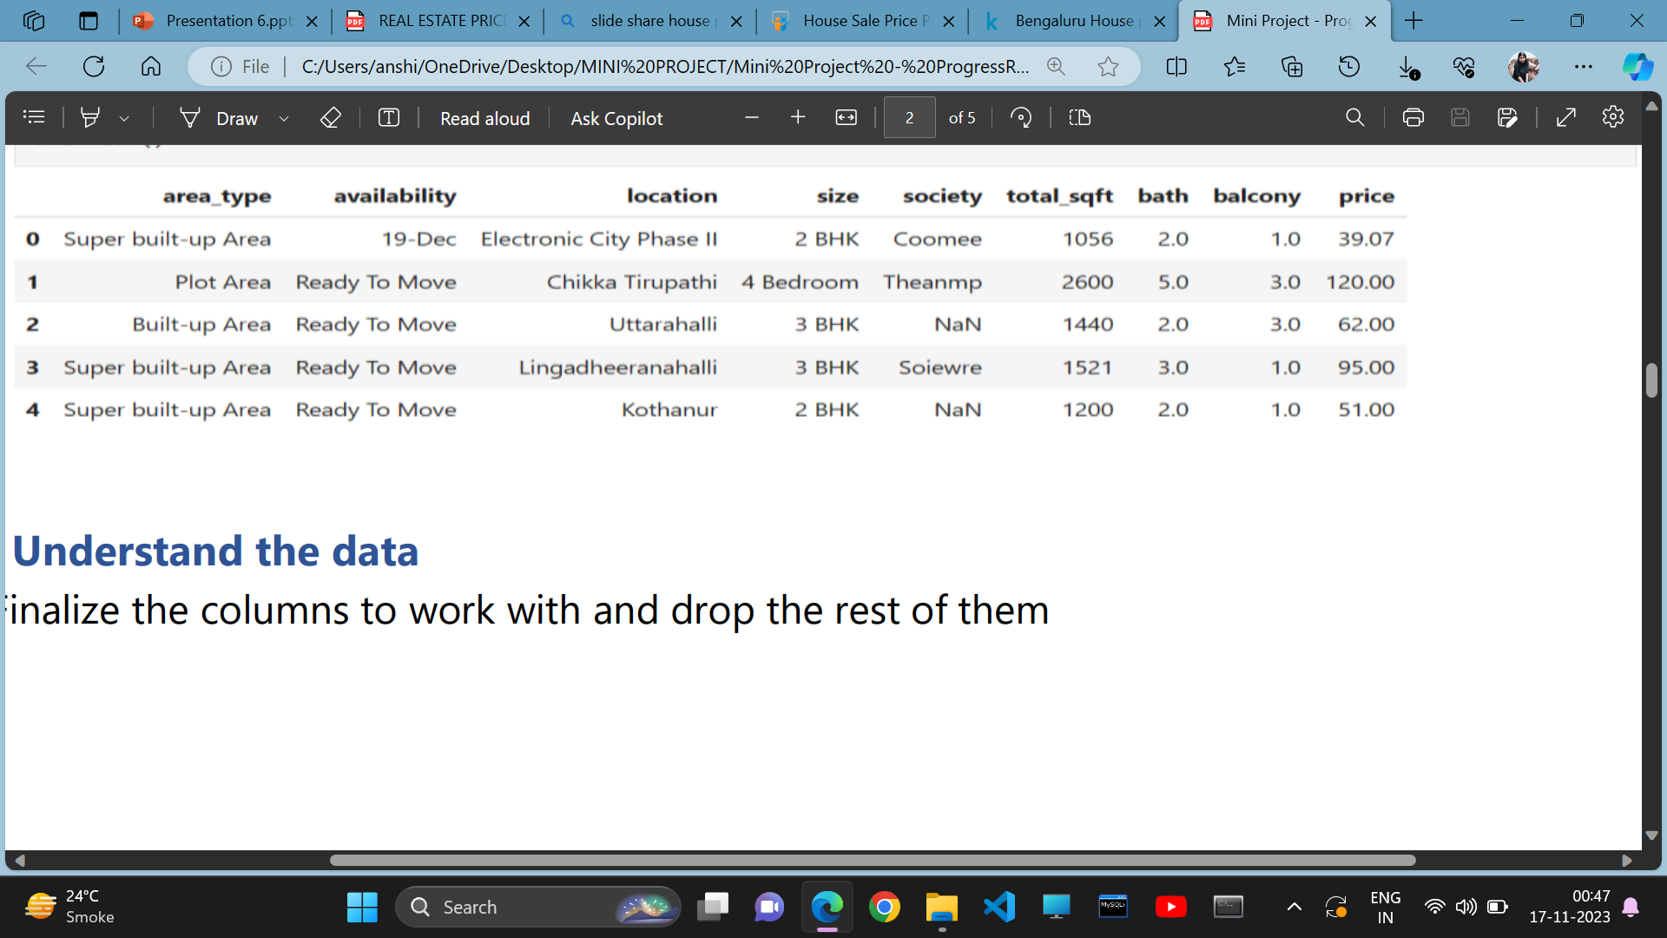
DATA SET -

Slide 14
FUTURE SCOPE - Future Scope and further enhancement of the Project The system's accuracy can be enhanced by increasing its computational power and size, allowing the inclusion of more cities. Introducing a different user interface for better visualization, utilizing Augmented Reality, will make the results more interactive and easier to understand. Creating a learning system to gather user feedback and preferences will personalize results for each user. Future includes comparing the system's predicted prices with real estate websites like MagicBricks.com to ensure reliability. To simplify things, the system will recommend real estate properties based on predicted prices. Adding G-map functionality to display nearby amenities like hospitals and schools within a 1 km radius will not only enhance user-friendliness but can also improve predictions, as these factors influence property values

Slide 15
REFRENCES -
Real Estate Price Prediction with Regression and Classification, CS/2016 • Aayush Varma, Abhijit Sharma, Sagar Doshi, and Rohini Nair, “House Price Prediction Using Machine Learning and Neural Networks (IEEE Paper)”
Rushab Sawant, Yashwant Jangid Tushar Tiwari, Saurabh Jain and Ankita Gupta, “Comprehensive Analysis of Housing Price Prediction in Pune using Multi-Featured Random Forest Approach (IEEE Paper)”.
Deploying a machine learning model on the Web using Flask and Python. | by Soumya Gupta | Analytics Vidhya | Medium
(PDF) House Price Prediction (researchgate.net)

Slide 16

THANK YOU

